Slide 1
Ministry of Higher Education Kabul university faculty of Information & communication technology
C++ Programming

Slide 2
Overview
What is a program?
Programming Languages
Compilers
C++ program
Layout of a C++ Program
Sample C++ Program
Testing and Debugging

Slide 3
What is a program?
A program is set of instructions for a computer to follow
Whenever we give a computer both a program to follow and some data for the program, we are said to be running the program on the data, and the computer is said to execute the program on the data.

Slide 4
Programming Languages
High Level Languages
C++
Java
Low Level Languages
Assembly Language
Add X Y Z
Machine Language
00011101

Slide 5
Compilers
Programs that translate a high-level language like C++ to a machine-language that the computer can directly understand and execute.

Slide 6
Preparing a C++ program for Running
C++ program
Source Code
Compiler
.exe
Object code for other routines
Object code for C++ program
Linker

Slide 7
Layout of a C++ Program
#include <iostream>
using namespace std;
int main()
{
Variable_Declarations
Statement_1
Statement_2
…
Statement_Last
return 0;
}
Program starts here
Program ends here

Slide 8
Layout of a C++ Program
#include <iostream>
using namespace std;
int main()
{
Variable_Declarations
Statement_1
Statement_2
…
Statement_Last
return 0;
}
include directive
standard namespace
main function
executable statements
return statement

Slide 9
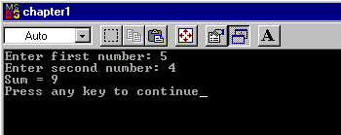
Sample C++ Program
#include <iostream>
using namespace std;
int main()
{
int number1, number2, sum;
cout << "Enter first number: ";
cin >> number1;
cout << "Enter second number: ";
cin >> number2;
sum = number1 + number2;
cout << "Sum = " << sum << “\n”;
return 0;
}

Slide 10
Sample C++ Program
Try this:
Write a program that displays the product of two integers
#include <iostream>
using namespace std;
int main()
{
int number1, number2, product;
cout << "Enter first number: ";
cin >> number1;
cout << "Enter second number: ";
cin >> number2;
product =…………………..?
cout << “Product = " << product << “\n”;
return 0;
}

Slide 11
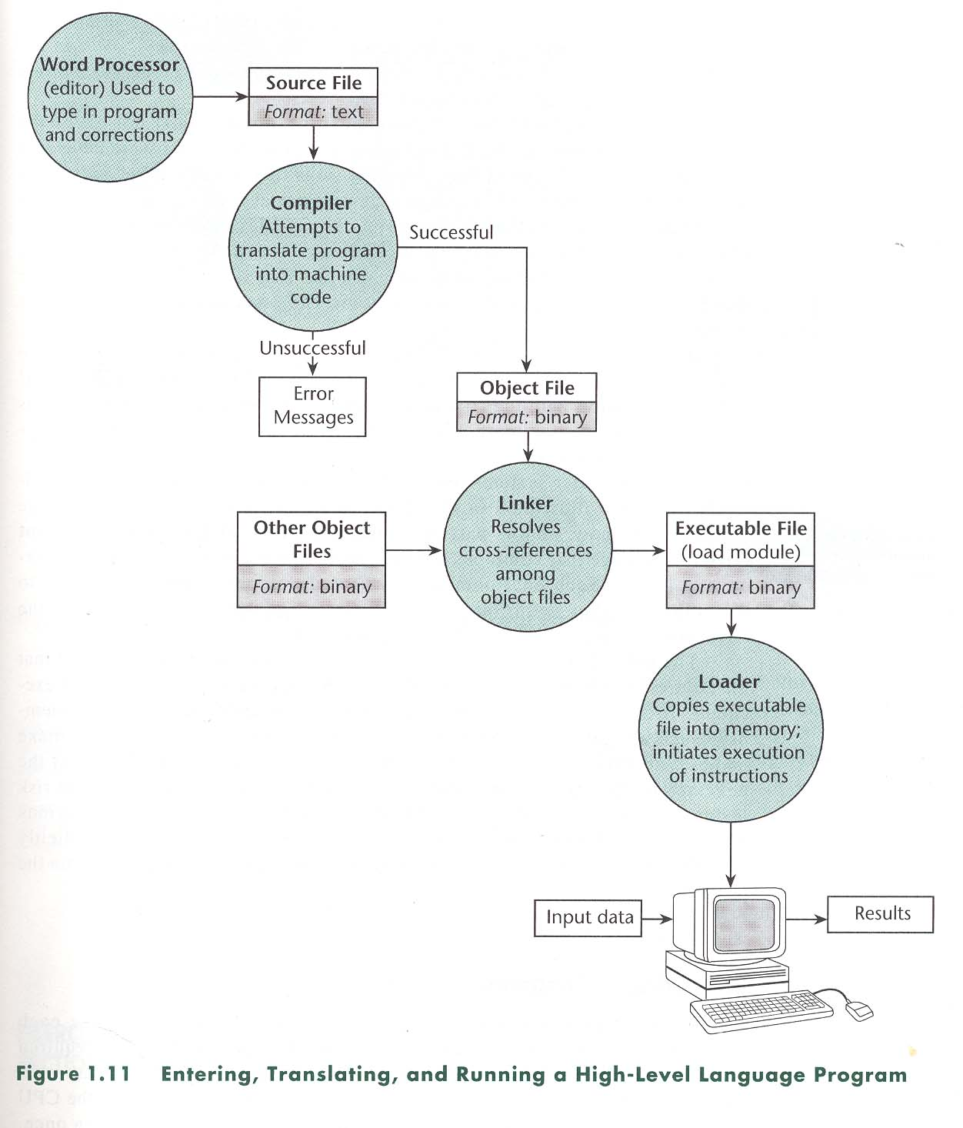
Compiling and Running a C++ Program

Slide 12
Testing and Debugging
Bug
A mistake/error in the program
Debugging
The process of eliminating bugs in a program

Slide 13
Testing and Debugging
Types of program errors:
Syntax errors
Violations of the rules of the programming language
Run-time errors
Detected by computers when the program is run (numeric calcualtions)
Logic errors
Mistakes in the underlying algorithm or translating the algorithm into C++ language

Slide 14
Thank You

